Slide 1
Assignment 2 Clarification

Slide 2
Identification in Path Models
Necessary Condition
If a necessary condition is met, the model may or may not be identified.
If a necessary condition is not met, the model is not identified.
Sufficient Condition
If a sufficient condition is met, the model is identified.
If a sufficient condition is not met, the model may or may not be identified.

Slide 3
Identification in Path Models
Necessary Condition
t-Rule
Order Condition Rule
Sufficient Condition
Null Beta Rule
Recursive Rule

Slide 4
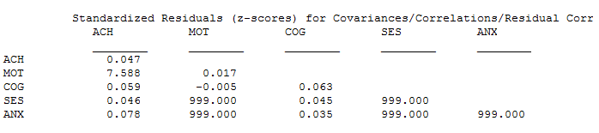
999 in Mplus Output
999 indicates that Mplus could not compute this standardized residual; it is not the value of the standardized residual.

Slide 5

999 in Mplus Output
The standardized residuals cannot always be calculated if the variance is negative.
Look at the normalized residuals.

Slide 6
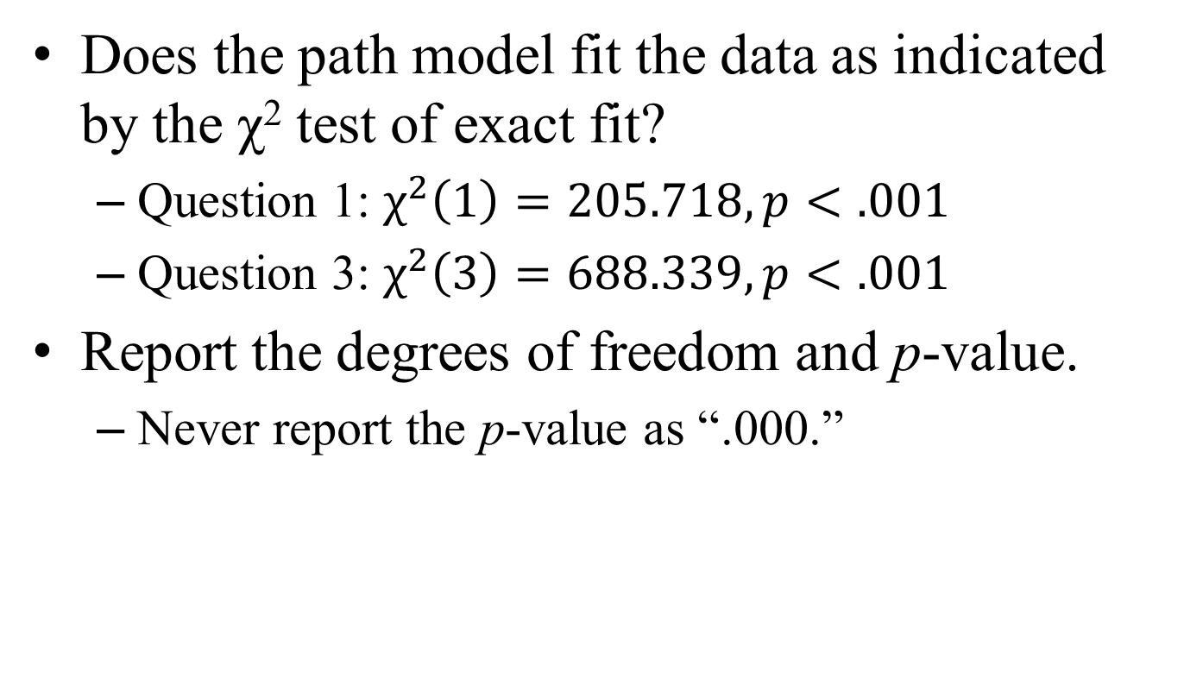
Reporting χ² Test of Exact Fit
Does the path model fit the data as indicated by the χ² test of exact fit?
Question 1: $χ^{2}\left(1\right)=205.718, p<.001$
Question 3: $χ^{2}\left(3\right)=688.339, p<.001$
Report the degrees of freedom and p-value.
Never report the p-value as “.000.”

Slide 7
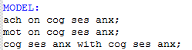
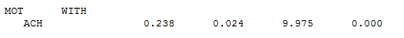
Question 1
For this path model, Mplus freely estimates the covariance between the disturbances by default.

Slide 8
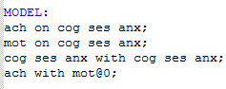
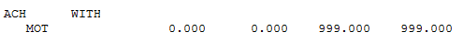
Question 1
Constrain the covariance between the disturbances to zero.
Notes:
Notice that Mplus reports 999 for the z-test and p-value.

